Slide 1

Virtual Energy Storage Team Energy Online Jiggar Shah, Michael Jordi, Michael Stemmle, Simon Oeschger, Stefan Zemljic

Slide 2
Problem - Reduce amount of nuclear energy by 2034 - Low incentives to set up PV - Expensive energy storage solutions Solution - Incentivize sustainable energy production - Virtual energy storage solution

Slide 3
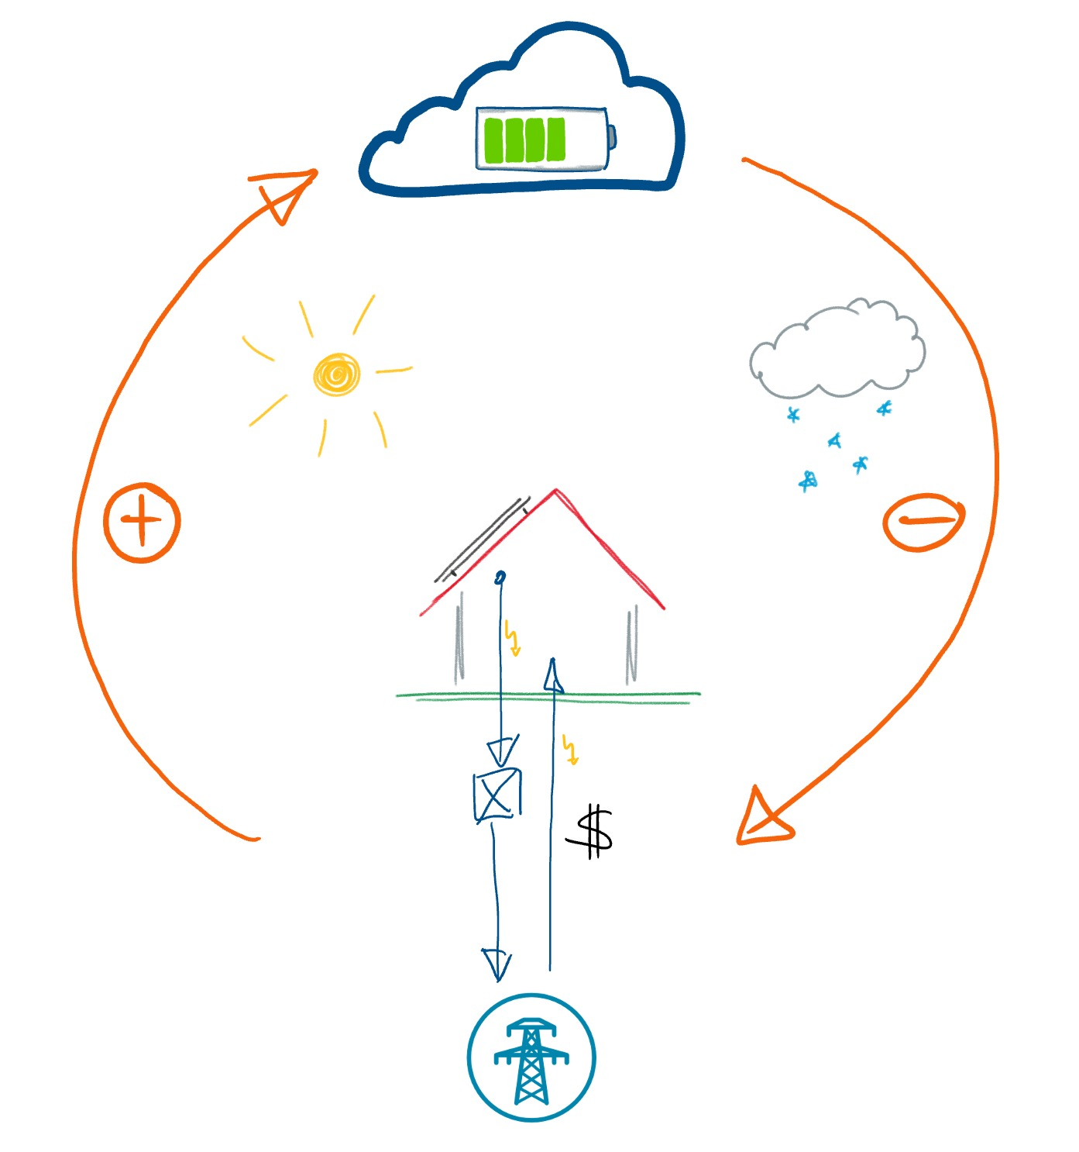
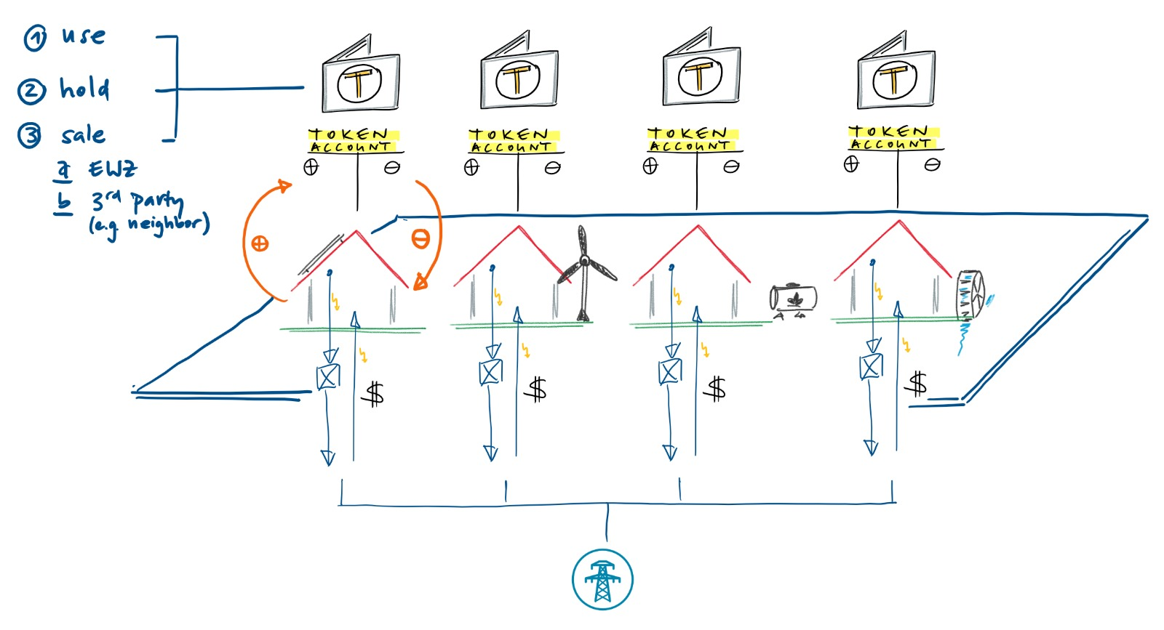
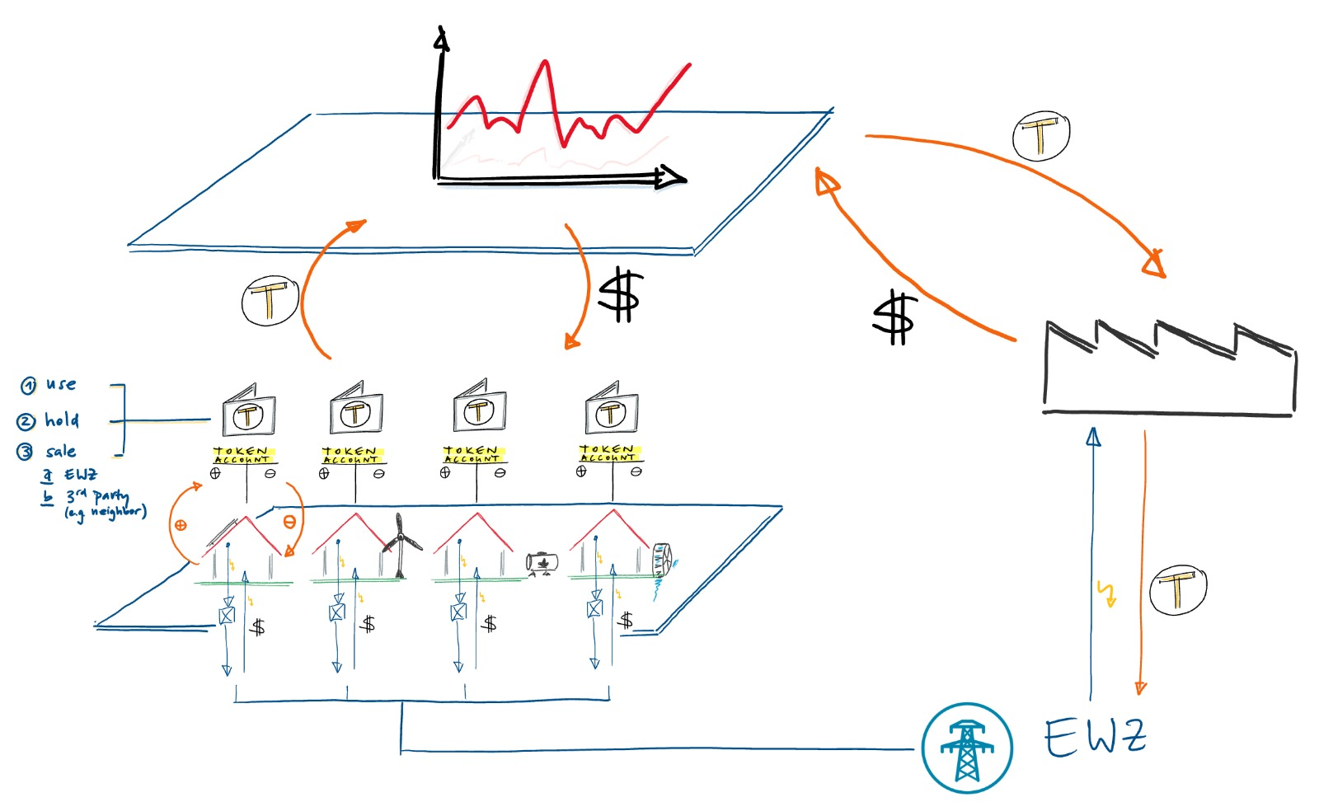

Slide 4
Disruption Potential
- Break up cantonal boarders
- Energy token enables new trading options
- Amplyfing with subsidees
- Could make energy trading for EWZ obolate
Difficulties / Open Challenges
- Smart meters and information tranfer needs secure
- Legal uncertainty (Certificats,..)

Slide 5
If available, short software demo

